Slide 1
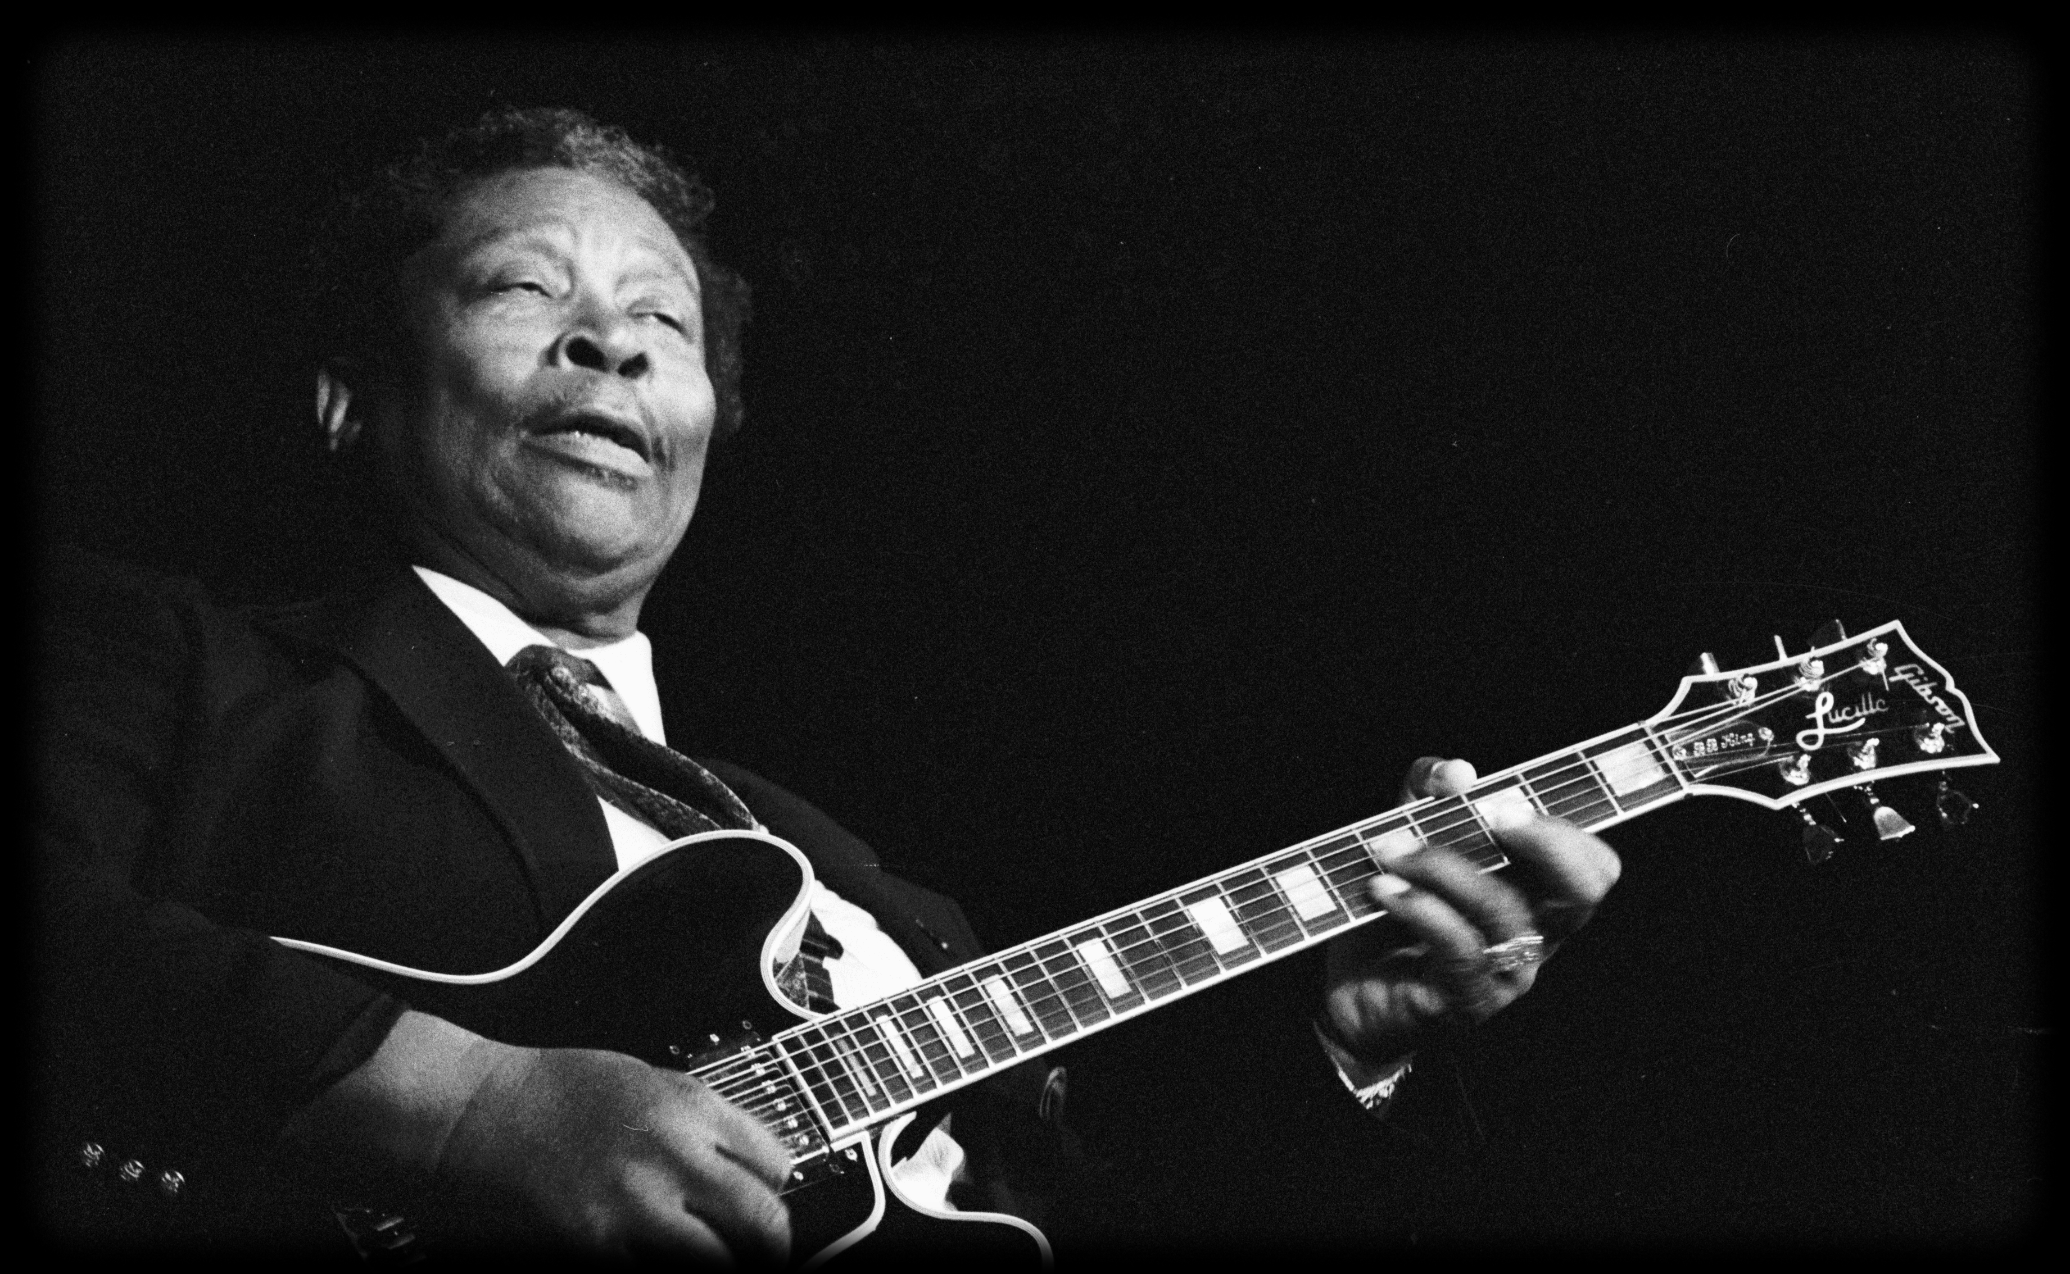
Black History Month Music of Black Origin
How The Blues Dominated The World

Slide 2
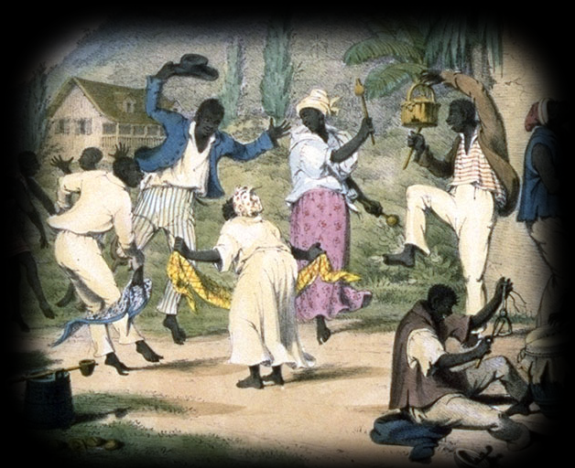
The Beginning of Blues
1500s, African slaves, plantations.
African music traditions.
“work-songs”, “field hollers”, “shouts”.
Singing and dancing while working.
Did the Africans have their own type of music?
Notes:
In the 1500s, many people from Africa were brought to America as slaves, to work on the cotton-plantations and on the farms.
Africans often use music, dancing and singing when they work, and they continued to sing and make music when they came to America.
These songs, are called “work-songs”, “field hollers” and “shouts”.
The Africans were singing together, and the movements of the work followed the rhythm of the music, almost like a dance!

Slide 3
African “Work Song”
Notes:
Full Video can be viewed at;
https://www.youtube.com/watch?v=D5Tpu0xLgn8
This video is subject to the Smithsonian Institution copyright and privacy policy (www.si.edu/copyright/).
And is used under the Fair Use Rule

Slide 4
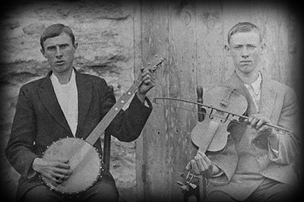
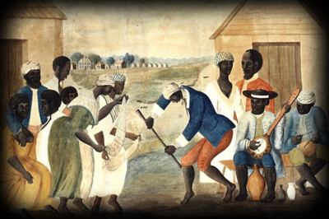
African music melded together with the American country music.
American instruments.
Guitars, Banjos, Harmonica and Violins.
Country music, Christian religious hymns.
Early 1900s, Blues form developed.
Notes:
The African slaves started to use the instruments that their owners had on the farms.
Guitars, Banjos, Harmonica and Violins, instruments the Africans did not have access to in Africa were used.
American music of the time, a country-type music, and Christian religious hymns, important influence on the slaves music.
In the early 1900s, the Blues was began to take form like we know it today, and eventually performers started to appear.

Slide 5
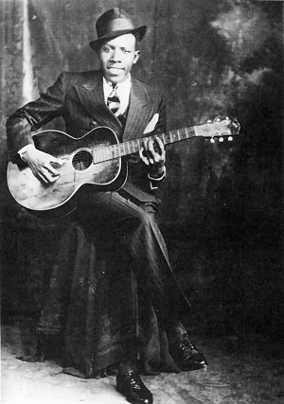
Mississippi Delta in the Early 1900s
The first Blues performers.
Repeating lyrics.
Simple form, few guitar chords.
Swinging and driving rhythm.
Love, freedom, sorrow, “blue”.
Country Blues, Delta Blues.
Who is the person in this photo?
Notes:
The first known Blues performers came from the Mississippi Delta, traveling around with a guitar, singing in the different communities.
The lyrics usually repeated much, and the music had a simple form, very few chords on the guitar, and a swinging and driving rhythm.
They usually sang about love, freedom, and about sorrow, and the sad things in life. Feeling “blue”.
This early type of Blues is called Country Blues, or Delta Blues.

Slide 6
Men, Guitars, and “Blue Notes”
Mostly men performed the Delta Blues.
Guitar, the most important blues-instrument.
Harmonica, glass bottleneck slide.
Melodies similar to work-songs, “blue notes”.
Tension, slightly out of tune.
Can anyone guess what the term “blue note” might mean?
Notes:
Usually it was men who was performing the blues music in the Delta Blues period.
The guitar became the most important instrument of the blues.
Sometimes the performers also played harmonica, and even used a glass bottleneck to make sliding sounds on the guitar.
The melodies was similar to the work-songs, and had something that we call “blue notes”.
Blue notes creates tension in the melody, and can sometimes sound out of tune, or false.

Slide 7
Robert Johnson
Notes:
For more about Robert Johnson see;
http://www.allaboutbluesmusic.com/robert-johnson/

Slide 8
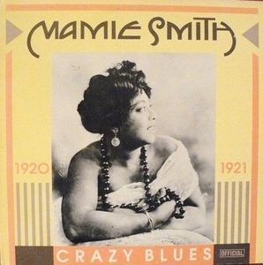
Urban Blues, Female Singers.
1920s, Blues in the cities.
Blues bands, larger audience.
Female singers.
The first Afro American blues record.
But why was Mamie Smith so Important?
Notes:
In the 1920s, Blues was starting to be popular in the cities.
Instead of only a man and a guitar, larger bands was formed, and they also played to a larger audience.
The female Blues singer, Mamie Smith, was the first to record a blues song in 1920, and other female singers also became popular.
These recordings was labelled “race music”, since the artists were black African Americans, and distinguished from the white artists.

Slide 9
Mamie Smith
Notes:
For More On Mamie Smith See;
http://www.allaboutbluesmusic.com/mamie-smith/

Slide 10
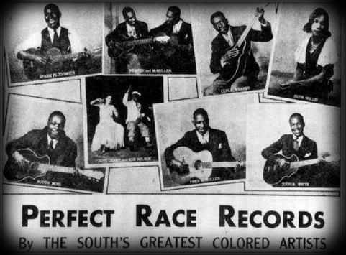
Race Music
“Race music”, distinguished from white artists.
Mostly sold to, or bought by black listeners.
Black or mixed audience.
Low payments and salaries.
Vaudeville.
Why do you think
the label “race music”
was changed to “rhythm and blues”?
Notes:
The music recorded by the African Americans, was labeled “race music”, and mostly sold to, or bought by, black listeners.
But, some of the most popular records was also bought by white listeners.
The black Blues singers had to perform at places that usually had a black, or a black and white mixed audience.
They also was traveling around, as Vaudeville performers, and the payment and salaries was very low.

Slide 11
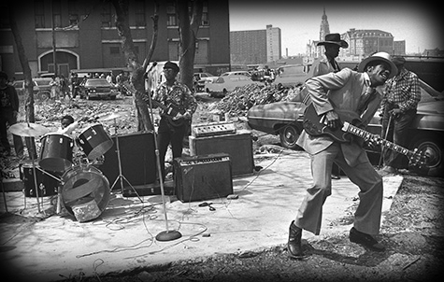
The Electric Blues in Chicago
1940s Chicago.
New instruments.
Electric guitar, electric organ, drums, electric bass and horns.
Rough feel, faster tempo.
The arrival of electric
instruments on the market
made an important change
in the music history, why?
Notes:
In the 1940s after the 2. world war, many African-american blues musicians moved to the cities, where they started to play in groups and bands.
They started to use new instruments, like the electric guitar, electric organ, drums, bass and horns. Electric slide guitar was popular.
Chicago became the most important city of the electric Blues.
The electric Chicago Blues, had a more rough feel, and sometimes a faster tempo.

Slide 12
Muddy Waters
Notes:
For More On Muddy Waters See;
http://www.allaboutbluesmusic.com/muddy-waters/

Slide 13
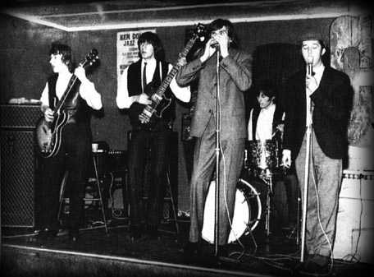
British Blues Boom
British people buy American Blues-records.
English bands playing Blues.
Black music was sold to white listeners.
Impact on the popular music in America and Europe.
What kind of impact do you think
the Blues had on the pop music?
Notes:
After the increasing popularity of the Blues, British people started to buy American Blues-records.
Many English bands started to play Blues, and some of them went to America to record their own Blues Cds.
The Blues and the black music was sold more and more to white listeners, and it had a very large impact on the popular music in both America and Europe.

Slide 14
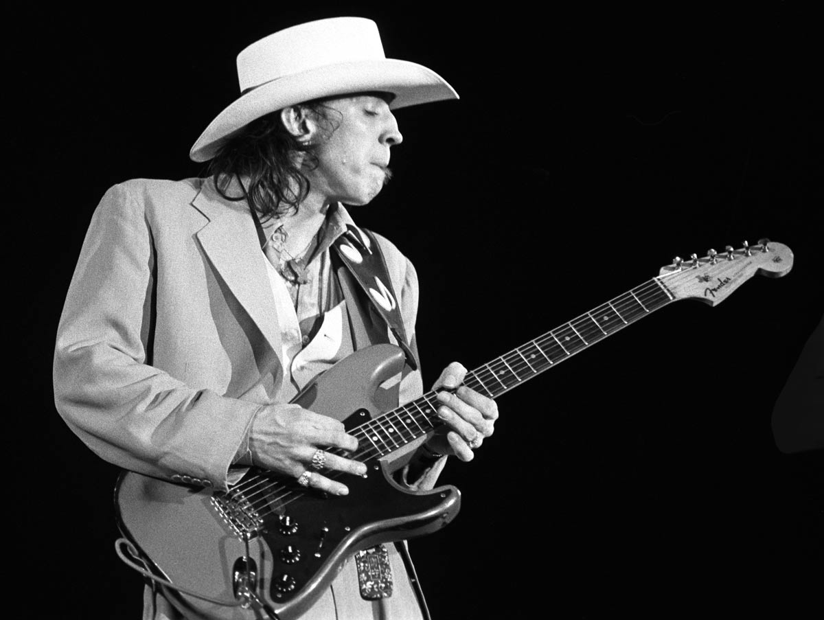
Blues in the Later Years
1960s, British blues bands.
Influence on American bands.
Mixed the blues with rock.
The Doors, Jefferson Airplane, Ry Cooder.
1970s Texas Blues.
1980s, Blues festivals, Blues comeback.
Notes:
In the 60s, many British Blues bands made an influence on American groups that mixed the blues with rock. (The Doors, Jefferson Airplane, Ry Cooder)
In Texas, the Blues got its own sound in the 1970s (Texas Blues), also heavily influenced of the British blues-rock movement.
In the 80s, outdoor Blues festivals started to be popular, some Blues bands made comeback and artists like Eric Clapton and John Lee Hooker released some important records.

Slide 15
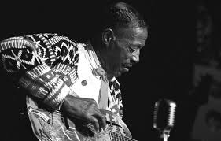
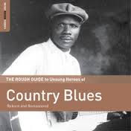
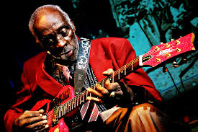
The Impact of Blues
An enormous importance in the history of popular music.
Blues influenced many movements and styles.
A large source of inspiration.
Interpreted all over the world, mixed with different styles, flourished in different forms.
Notes:
The Blues made an enormous importance in the history of popular music, it influenced many movements and styles in the 20. century of music, and still is a large source of inspiration for the new and currently emerging music.
Blues has been interpreted all over the world, mixed with different styles, and has flourished in many different forms.

Slide 16
The Blues Today

